Slide 1
Robust Robotic Grasping Utilising Touch Sensing
Meeting – March 3, 4:30pm GMT

Slide 2
Baseline
Logistic regression model – aims to find best data representation
Features: combinations of tactile and visual data
Labels: Manually recorded grasp outcomes (successful / unsuccessful)
# examples: 400 per outcome
Data used (before dimensionality reduction):
Tactile data (sensor readings) - concatenated depth (2x160x120) and color (2x160x120x3) readings into: 160x240x4=153600
Visual data (6D gaussian end effector poses): 6
Both (concatenated data): 153606
PCA: 3 components – N*3
CNN: 3 layers – N*128

Slide 3
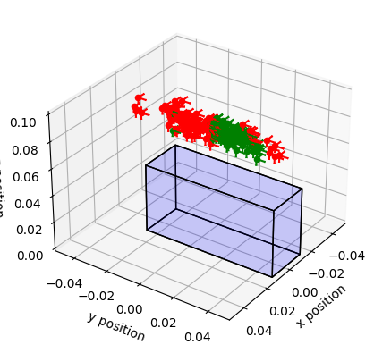
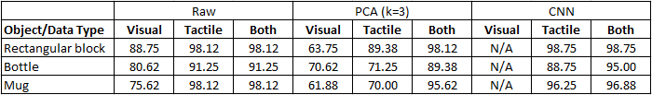
Baseline results
Visualising end effector poses on a block
Red = failed grasp
Green = successful grasp
Clear decision boundary for LR model
Previous results (50% for visual data) was due to lack of normalisation
Previous problem of using orientation data only yielding bad accuracy was due to insignificant applied noise (adding more noise solves the problem)

Slide 4
GP generative model – data collection
Train a GP per primitive object type (block, cylinder, etc) using CNN-processed tactile + visual data
Aim for 18-20 dimensions (tactile: 6D, visual: 6D, geometric 6D (W,H,D, convexity, curvature…))
Collect geometric features using point cloud (instead of URDF files)
Ensure proposed features to collect are useful in distinguishing different classes of objects (e.g. via spectral clustering)

Slide 5
GP generative model - training
For every object type, manually select e.g. 10 poses
Determine if the current pose is good given object features
Experimental: Execute grasp, get the tactile data and do inference using object features + tactile data, then infer a new pose to see if it is close to the executed one
If generative model idea fails, try to infer successful grasps using given vision and tactile data only

